Slide 1
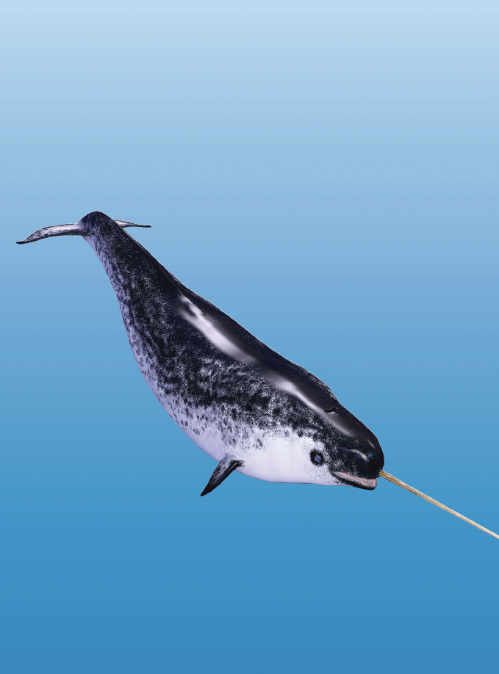
Teaching Resources and Instructors’ Guidelines
Chapter 6: Sources of innovation

Slide 2
Chapter 6: Sources of innovation
In the following PowerPoint slides you will find the key headings from CHAPTER 6 together with the main illustrations, tables, etc.
There are also slides summarizing the key messages in bullet-point fashion, and a wide range of activities which you can use to help students explore around these themes.
Finally there are some reflection questions which can be used as the basis for discussion or assignments.

Slide 3
Learning Objectives
By the end of this chapter you will develop an understanding of:
where innovations come from – the wide range of different sources which offer opportunities to entrepreneurs
the idea of ‘push’ and ‘pull’ forces and their interaction
Innovation as a pattern of occasional breakthrough and long periods of incremental improvement
the importance of different sources over time
where and when you could search for opportunities to innovate.

Slide 4

Futures and forecasting
Regulation
Accidents
Design-driven and experience innovation
Knowledge push
Recombinant innovation
Sources of innovation
Need pull
Prototyping and experiment
Benchmarking/ learning from others
Process improvement
Crisis driven and extreme contexts
User –led innovation
Mass customisation
Frugal innovation

Slide 5

Core themes and material from the book

Slide 6
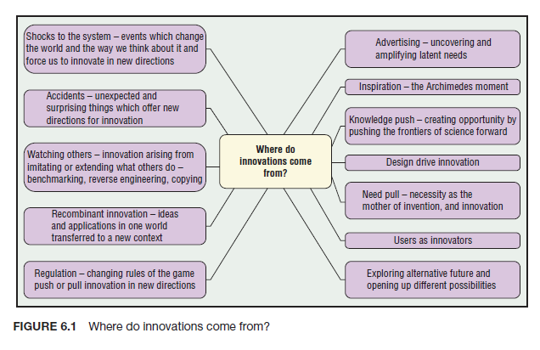
Where do innovations come from?
Figure 6.1 of the book indicates the wide range of stimuli which can begin the innovation journey

Slide 7
Sources of innovation
Knowledge push
Need pull
Product innovation
Process improvement
Crisis-driven
Frugal innovation
Mass customization
User-led innovation
Prototyping
Benchmarking
Recombinant innovation
Design-driven innovation
Regulation
Futures and forecasting
Accidents

Slide 8
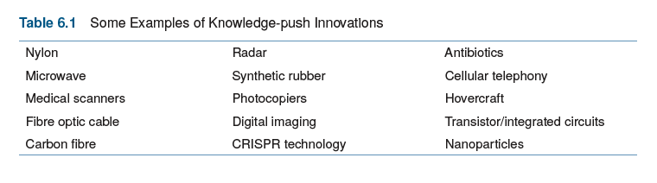
Knowledge push innovation

Slide 9
Types of product innovation
Figure 6.2 of the book indicates a typical breakdown, and we could construct a similar picture for process innovation

Slide 10
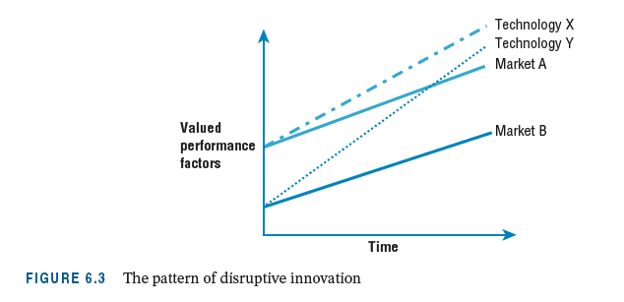
Disruptive innovation

Slide 11
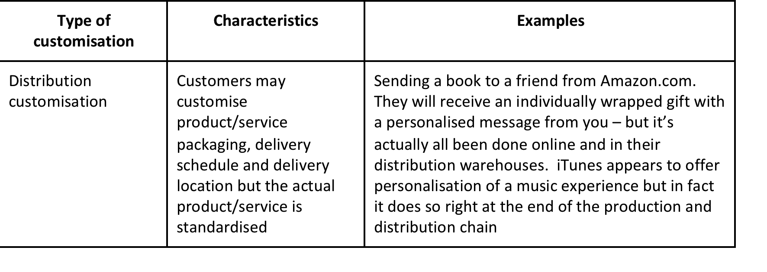
Mass customization
Table 6.1 of the book summarises options in customization (after Mintzberg and Lampel)

Slide 12
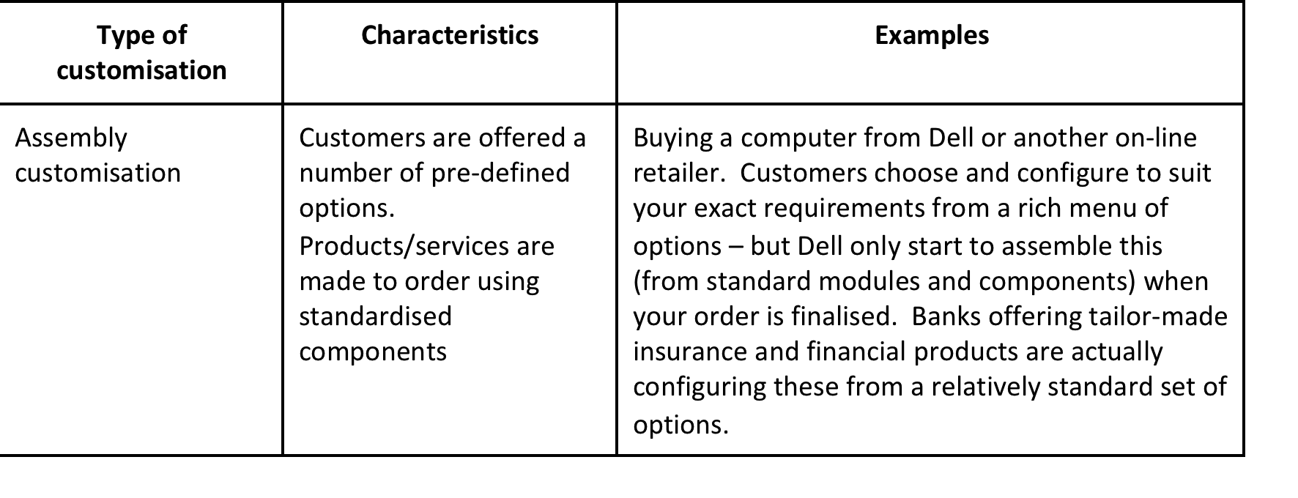
Mass customization (continued)

Slide 13
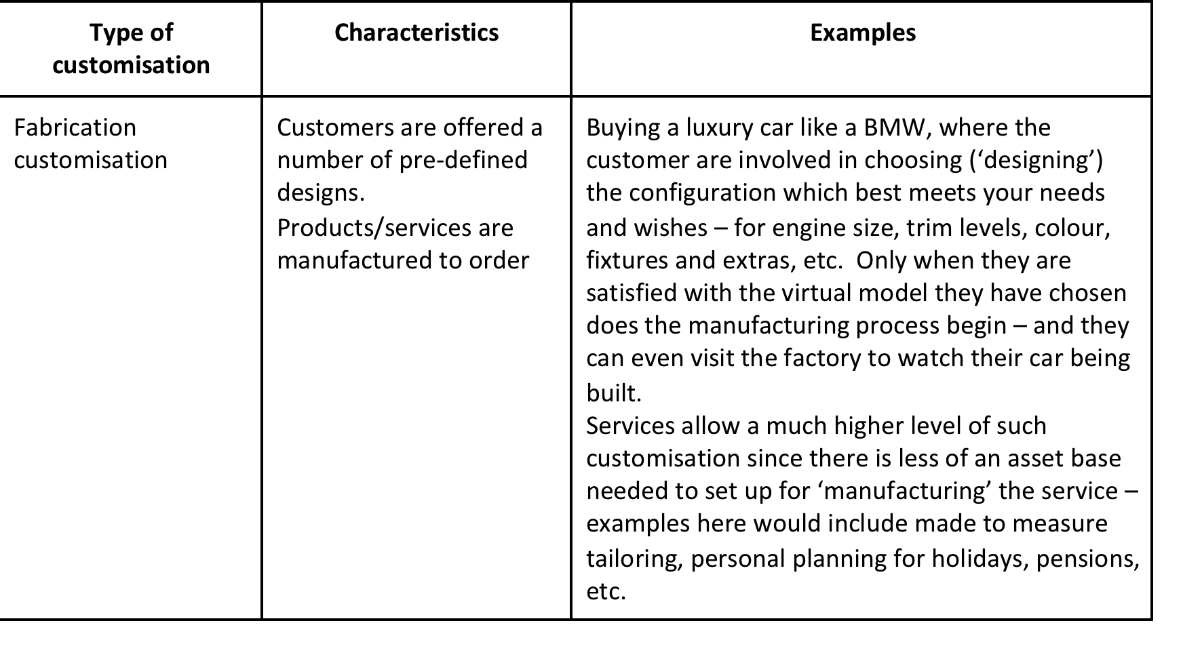
Mass customization (continued)

Slide 14
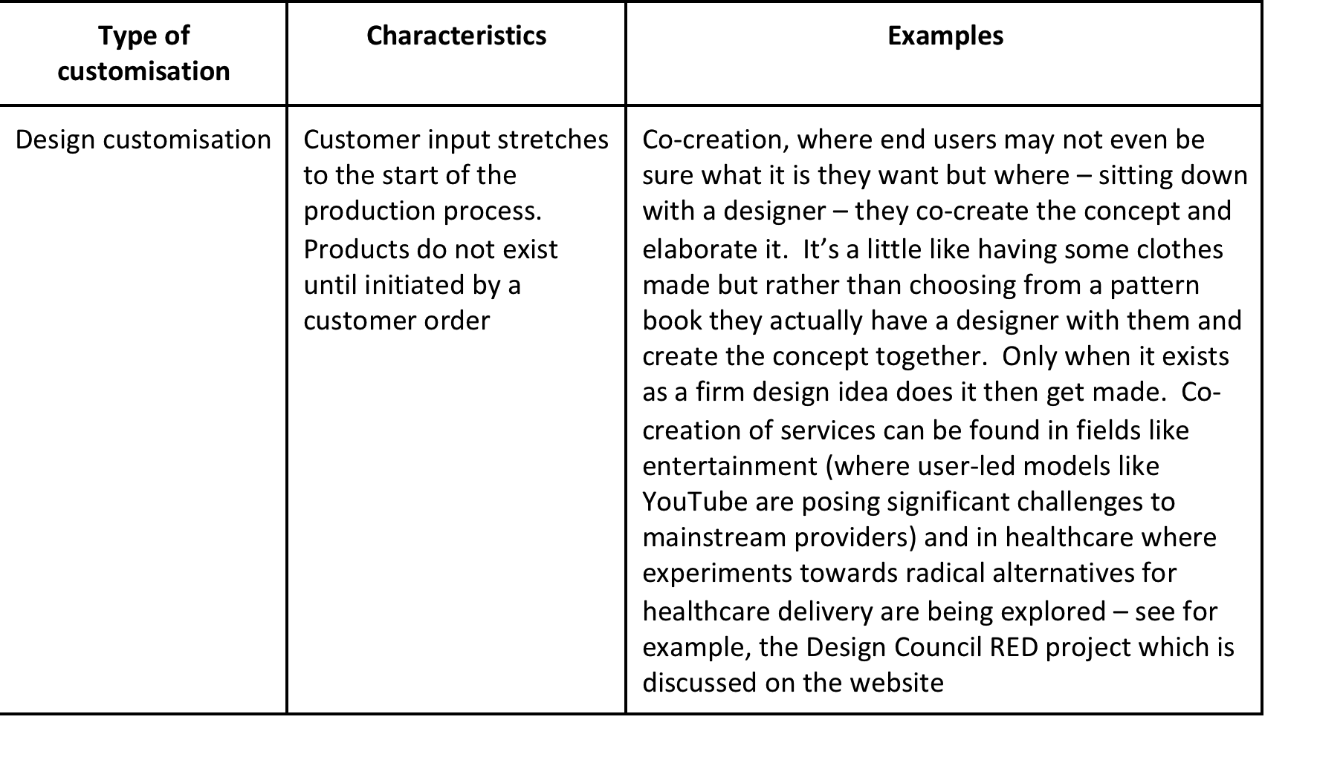
Mass customization (continued)

Slide 15
Design driven innovation
Radical
change
Technology push
Technology
Design-driven
Market pull
(user centred)
Incremental
change
Incremental
change
Radical
change
Meaning
Source: Based on R. Verganti (2009) Design-Driven Innovation. Harvard Business School Press

Slide 16
Summary
Innovations come from many different sources
Innovations don’t just appear perfectly formed – and the process is not simply a spark of imagination giving rise to changing the world. Instead innovations come from a number of sources and these interact over time.
Sources of innovation can be resolved into two broad classes – knowledge push and need pull – although they almost always act in tandem. Innovation arises from the interplay between them.

Slide 17
Summary
There are many variations on this theme – for example, ‘need pull’ can include social needs, market needs, latent needs (squeaking wheels), crisis needs, etc.
Whilst the basic forces pushing and pulling have been a feature of the innovation landscape for a long time, it involves a moving frontier in which new sources of push and pull come into play.
Examples include the emerging demand pull from the ‘bottom of the pyramid’ and the opportunities opened up by an acceleration in knowledge production in R&D systems around the world.

Slide 18
Summary
Users are a rich source of innovation ideas and can help accelerate diffusion
Regulation is an important element in shaping and directing innovative activity – by restricting what can and can’t be done for legal reasons, new trajectories for change are established which entrepreneurs can take advantage of
Accidents, crises and extreme conditions can provide unexpected triggers for novel directions

Slide 19

Videos
There are several videos which can help explore and present the key themes of the chapter:
knowledge push and need pull as sources of innovation
examples of knowledge push innovation
different kinds of need pull innovation:
Incremental improvement
Radical innovation
Disruptive innovation
Notes:
Short videos

Slide 20
Videos
Other films which explore in more detail:
User-led innovation (part 1)
User led innovation part 2
Interview with Pedro Oliveira talking about the Patient Innovation platform, a way of mobilizing user innovators in the healthcare space
Mandy Haberman talking about user innovation
Interview with Helle-Vibeke Carstensen talking about innovation search in the public sector
Hugh Chapman, Managing Director of Veeder Root on continuous improvement
Finding innovation opportunities in healthcare settings
Emma Taylor and employee innovation
The birth of bike
The birth of mp3
Sweeping the floor with innovation

Slide 21
Videos and audio
Interview with Michael Bartl of Hyve, talking about the use of ‘netnography’ in the search for new innovation opportunities
Interview with Tim Craft (audio and video) talking about his experience as a user-innovator
Interview with Catharina van Delden and her company Innosabi which mobilizes external communities as a source of innovation for businesses
Interview (audio) with Helen King of the Irish Food Board talking about their use of futures methods to search for innovation opportunities
Interview with Lynne Maher, UK National Health Service talking about user experience as a source of innovation

Slide 22
Disruptive innovation
Follow the link below to watch a video briefly explaining Clay Christensen’s theory of Disruptive Innovation
https://www.youtube.com/watch?v=mbPiAzzGap0
Follow the link below to watch Ted Graham’s TED Talk, ‘Three things I learned about disruptive innovation as an UberX driver’
https://www.youtube.com/watch?v=4L30uIkMeMM

Slide 23
Human-centred design
Follow the link below to watch David Kelley’s TED Talk ‘Human-centred Design’
https://www.ted.com/talks/david_kelley_on_human_centered_design

Slide 24
Blogs and podcasts
There are several podcasts and blogs picking up key themes around sources of innovation and some of the key variables. See, for example:
Birth of the bike
An innovation birthday party
Flirting with ideas
Frugal innovation
Recombinant innovation

Slide 25
Activities
There are a variety of activities (for both groups and individuals and for online as well as offline work. These include:

Slide 26
Where do innovations come from?
On the portal there is an exercise ‘Innovation family trees’ which helps to explore the theme of sources of innovation:
Ask students to pick a sector – e.g. food retailing, airlines, chemicals, public administration – and draw a map of their particular version of this process. How does it work out in practice? Where are they likely to need to place most emphasis?
https://johnbessant.org/wp-content/uploads/2020/06/Innovation-family-trees.pdf

Slide 27
Activity (team or individual)
Choose some examples of product, service or social innovation - for example, a smart phone, an electric car, online booking of hospital appointments or enabling literacy programmes in Africa via mobile phones. Now try and work backwards - draw out the ‘family tree’ of triggers which brought that innovation into being. What were the enabling ‘pushes’ – (for example, where did the technology come from?) - and what were the ‘need pulls’?

Slide 28
Activity – innovation histories
Innovations don’t just appear - sometimes they involve a lot of competing ideas before a ‘dominant design’ emerges. Henry Ford wasn’t the first car maker but his was the design which ‘clicked’ with the market. Apple’s i- Pod wasn’t the first mp3 player - but it became the dominant architecture which others then copied. South West Airlines weren’t the first low cost carrier but they established the model which other successful players like Ryanair, Easyjet, Air Berlin and Air Europa have followed. Taking an example of an established innovation category like these, try and reconstruct the case history. Where did the original idea come from and what forces - pushes and pulls - shaped its emergence into a dominant design?
Read the blog piece on the birth of the bike to give an idea of the task

Slide 29
Activity – Sources of innovation
Select a company of your interest and explore how they search for innovation opportunities. Which of the approaches described in the chapter do they use and how?
If possible, interview the manager(s) on sources of innovation and how they manage the process inside the company. Provide a short report based on the field research, making conclusions, outlining limitations and suggesting further research in the area.

Slide 30
Knowledge push innovation
On the website there are many examples of knowledge driven companies – 3M, Spirit, Corning, P&G, Hella. Ask students to research examples focusing on how these companies built their strength. What’s their core knowledge base that they create and exploit?

Slide 31
Need pull innovation
Ask students to list examples of need pull innovations in different sectors and try to characterize them in terms of whether they are incremental improvements or radical new to the world ideas.

Slide 32
Understanding user needs
Watch the video of Michael Bartl talking about new approaches to market research via ‘netnography’
Look at the tools which can help research user needs
Try to use some of them to identify and research potential market needs for new product or service idea

Slide 33
Making processes better
Tools to help find opportunities for innovation include:
Lean toolkit and activities
Try using some of these tools to help identify opportunities to improve a process in your workplace

Slide 34
Process mapping
Look around for a process which might benefit from improvement – for example anywhere there is a queue means that the process isn’t working as smoothly as it might and people are wasting their time and energy waiting.
Use the process mapping tool to try to identify ways of improving it

Slide 35
Activity – Disruptive innovation
Watch the video of Clay Christensen explaining his theory of disruptive innovation
Research the topic more widely
Where and when might an organization use this approach to help identify new opportunities for innovation?

Slide 36
Activity – Frugal innovation
Read the blog piece on frugal innovation
Where and how might an organization find inspiration for new innovation directions in this approach?

Slide 37

Activity – Crowdsourcing ideas
There are many online innovation contests asking for user input. Ask students to research websites to find an opportunity to co-create and participate.
Get them to review these and present back (using screen shots) explaining how they are being invited to participate in innovation. What might the challenges be in using this approach to finding innovation opportunities for an organization?
(Thanks to Hagen Habicht, HHL Leipzig for suggesting this exercise)

Slide 38
Activity: The challenge of customisation
Look at the Model T Ford case and explore the innovations involved
Watch the Frank Piller video about the challenges in exploiting the new ‘mass customization’ opportunities and the implication of the ‘3D printing’ for business models
https://www.youtube.com/watch?v=4WsZUdbPKcI
Ask students to study these cases and present about the challenges involved in delivering mass customization. Then, ask students to design a customized offering and think about the innovation behind the scenes needed to bring it about.

Slide 39
Activity: User-led innovation
Watch these Von Hippel videos explaining user innovation methods:
https://evhippel.mit.edu/teaching/
Watch the ITN videos about user innovation
https://youtu.be/FU9aewJRX9I
https://youtu.be/WkcnyY04mkY
Ask students to study these resources and prepare a short report (or a presentation) on the main points involved in adopting this approach.

Slide 40
Activity: Recombinant innovation
Read the blog piece on recombinant innovation
Look at the Aravind case study where eye clinics particularly took inspiration from McDonalds
Ask students to find a problem area in an organization and then look for analogue industries/areas from where they can learn.

Slide 41
Activity: Learning from others
On the website there are tools to explore on:
Benchmarking
Competitiveness profiling
Value curves (Blue Ocean)
Activity - ask students to provide examples on how these tools could be used to find opportunities for product and/or process innovation

Slide 42
Activity: Regulation
Ask students to research an example of a regulated sector and highlight how innovation happens in response to this, and to try and get around this.

Slide 43
Activity: Futures and forecasting
Ask students to make use of some of the tools in the Futures Toolkit to present pictures/scenarios of the future and potential innovation opportunities emerging from this.
As a variant you could allocate different tools to each group of students and ask them to compare their usefulness.

Slide 44
Activity: Accidental innovation
Read the blog post on accidental innovation
Ask students to research examples of innovations which have come about by accident, and prepare a presentation describing the story and the lessons which it offers innovation management.
(Examples might be Post-it notes, Viagra)

Slide 45
Cases
There are several case studies which highlight key themes in the chapter, including:
M-PESA, Field Ready, Lifespring Hospitals, Aravind and NHL where extreme conditions trigger new innovation directions
Humanitarian innovation as an example of crisis as a driver

Slide 46
Cases
Spirit, a Russian company which draws on the extensive knowledge base built up during the Cold War around voice recognition technology to provide solutions for major global companies like Cisco and Oracle
Dyson demonstrates a similar theme, using a science-based approach to rethink appliances like washing machines, cooling fans and hand driers
Case studies of Philips, Kodak and Cerulean that offer examples of disruptive innovation challenges and responses
Case studies of Lego, Adidas and Threadless which illustrate the move toward mass customization

Slide 47
Cases
Case study of Kodak which has been able to reuse its strong knowledge base in coating photographic film (which became redundant as the industry moved to digital images) in the field of high speed, high volume printing.
There is also a case study of Fujifilm which made a similar move away from photography, deploying its deep knowledge base to enter new fields in skincare
Aravind, NHL and Lifespring all offer insights into how emerging and underserved markets can drive different innovation trajectories
Yellowberry gives an insight into user innovation
Lego, Threadless and Local Motors all offer insights into how user communities can be mobilized to support innovation

Slide 48
Cases
Follow the link below to listen to a podcast on how architecture firm, Elemental, responded to a 2010 earthquake in Constitución, Chile
https://99percentinvisible.org/episode/half-a-house/

Slide 49
Assessments
The following slides offer some example assessment questions and discussion themes for individual or group activity

Slide 50
Assessments
1. Where do innovations come from? List as many possible sources as you can, providing examples.
2. What are knowledge push and need pull innovations? Explain, providing examples from different industries and sectors.

Slide 51
Assessments
What are User-Led Innovation & Lead user methods? How do these two approaches impact the innovation process inside organisations. Provide examples, explaining the concepts.
4. Imagine Nick Smith has just been promoted inside a big company and his new tasks are to work on the future. Help Nick to explore the ways in which futures can be used to drive an innovation agenda.

Slide 52
Assessments
5. Push and pull - which is more important? This question has worried managers and policy makers for decades - and having an idea of the answer would help focus support for the innovation process more effectively. Using examples try and show how each is important under certain conditions, but that it is their interplay which really shapes innovation.
6. Taking each of the ‘4P’s’ of innovation which we introduced in chapter 1, try and identify examples of ‘product’, ‘process’, ‘position’ and ‘paradigm’ innovation - and in each case list the sources which gave rise to those innovations.

Slide 53
Assessments
7. Julia Wilson is keen to use her skills in creating social enterprises. Where might she look for sources of inspiration on which to focus her entrepreneurial enthusiasm?

